Slide 1
CS246: Relevance Feedback
Junghoo “John” Cho
UCLA

Slide 2
Final Logistics
Friday 4-6PM, December 11 (PST)
Format will be similar to paper-based finals
We will share a sample final from last year
Released on Gradescope, proctored on Zoom
Answer to be scanned/pictured/type and uploaded on Gradescope
Closed book, closed notes
1-page cheat sheet (double-sided), calculator allowed
Friday 8-10PM, December 11 (PST)
For students in different time zone
8-10AM (6), 9-11AM (1), 6-8PM (1), 4:30-6:30AM (1)

Slide 3
Improving Search Engine Via User Feedback
Q: Once we deploy a search engine, can we improve it through user interaction?
Q: How can users’ “feedback” be used?
A: Possibilities
Rerank documents
Evaluate ranking function
Expand benchmark query set

Slide 4
Obtaining User Feedback
Q: How can we obtain feedback from users?
A: Explicit vs Implicit
Explicit feedback
Solicit explicit feedback from users on relevance, e.g., “how did you like the page?”
Implicit feedback
“Infer” user’s feedback from their behavior, e.g., “did the user click?”
Q: Pros and cons of each approach?

Slide 5
Explicit vs Implicit: Pros and Cons
Explicit feedback
Pro: “feedback data” is reliable
Con: users are unlikely to provide explicit feedback
Implicit feedback
Pro: plenty of data!
Con: ambiguous and unreliable relevance signal

Slide 6
1. Relevance Feedback
Given query $q$, user indicates$\left(d_{1}:1\right), \left(d_{2}:0\right), \left(d_{3}:0\right), \left(d_{4},1\right), ….$ Change ranking based on the user’s feedback
Q: How can we change ranking based on this feedback?
Basic intuition
Feedback “clarifies” user’s intension behind a query
Modify query based on user’s feedback
Many different approaches exist on how to refine queries based on user feedback

Slide 7
Rocchio Algorithm for Vector-Space Model
Modify the query-vector $\vec{q}$ based on user’s feedback
R: set of “relevant” pages indicated by the user N: set of “irrelevant” pages indicated by the user
${\vec{q}}^{′}=\vec{q}+α\sum_{\vec{d}∈R}{\frac{\vec{d}}{|R|}}−β\sum_{\vec{d}∈N}{\frac{\vec{d}}{|N|}}$
Intuition: move the query vector “towards” the center of relevant documents and “away from” the center of irrelevant documents

Slide 8
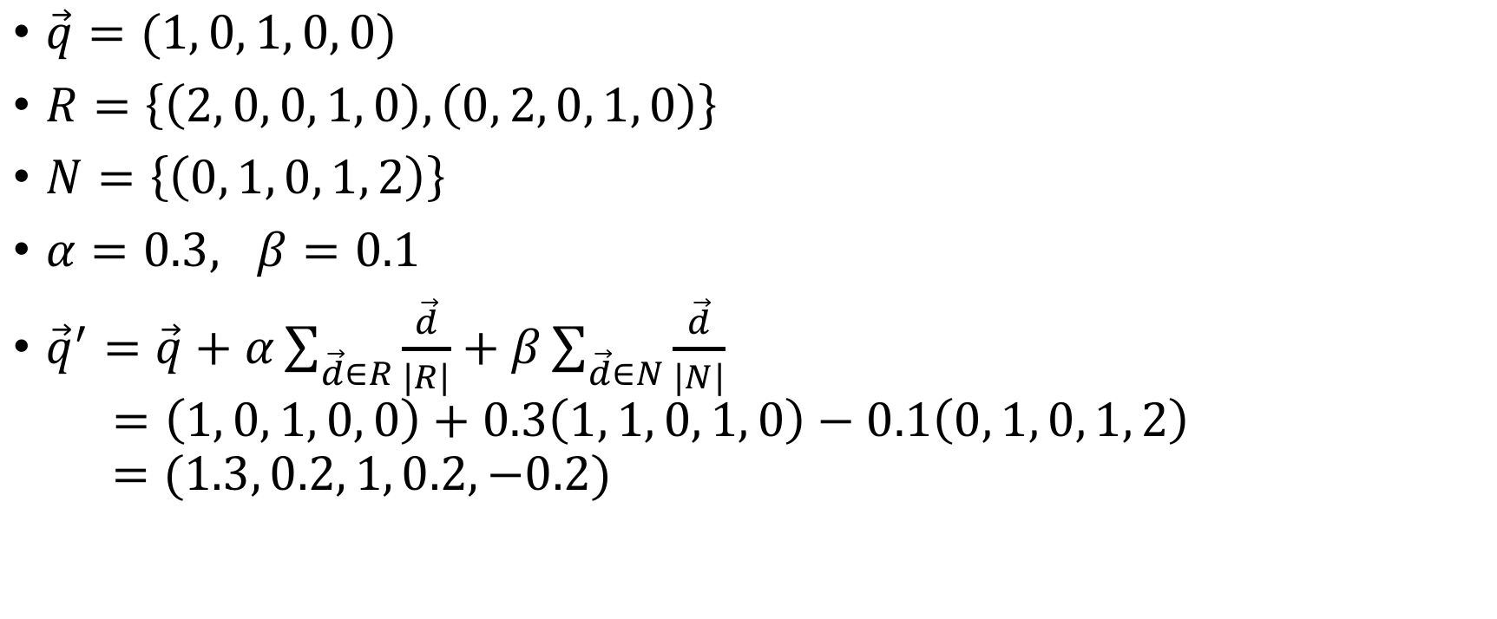
Rocchio Algorithm: Example
$\vec{q}=(1, 0, 1, 0, 0)$
$R=\left\{\left(2, 0, 0, 1, 0\right), \left(0, 2, 0, 1, 0\right)\right\}$
$N=\left\{\left(0, 1, 0, 1, 2\right)\right\}$
$α=0.3, β=0.1$
${\vec{q}}^{′}=\vec{q}+α\sum_{\vec{d}∈R}{\frac{\vec{d}}{|R|}}+β\sum_{\vec{d}∈N}{\frac{\vec{d}}{|N|}}$ $=\left(1, 0, 1, 0, 0\right)+0.3\left(1, 1, 0, 1, 0\right)−0.1\left(0, 1, 0, 1, 2\right)$ $=(1.3, 0.2, 1, 0.2, −0.2)$

Slide 9
Pseudo Relevance Feedback
Main idea
Queries are too short and ambiguous
Documents matching the query provides more context and meaning of the query
Better “infer” the meaning of query from top-matching documents!
Consider top-k ranked documents as relevant (without explicit user feedback)
Modify query based on the top-k ranked documents
Result
Often improves recall (with limited improvements in precision at top)
Result is difficult to control and unpredictable for users
Tricky to use on a noisy corpus

